Slide 1
2023-04-28

Slide 2
Upcoming Schedule
Monday | Wednesday | Friday
04/24/2023 (90) • Review: Unit 8 • AP CS Question 4: 2D Array | 04/26/2023 (90) • AP CS Multiple Choice Game | 04/28/2023 (45) • Review: Unit 7, Unit 10 • Algorithms: Iterative/recursive binary search, selection sort, insertion sort, merge sort
05/01/2023 • FINAL | 05/03/2023 • AP EXAM

Slide 3
Searching and Sorting
(from Units 7 and 10)

Slide 4
Sequential Search (aka Linear Search)
for i ← 0 to length(array)-1 if array[i] == targetValue return i end if end for return not found
Pro: You can search for an item in any unsorted list and it is guaranteed to be found if it exists in the array
Con: If you’re searching a long list, this can be a very slow approach

Slide 5
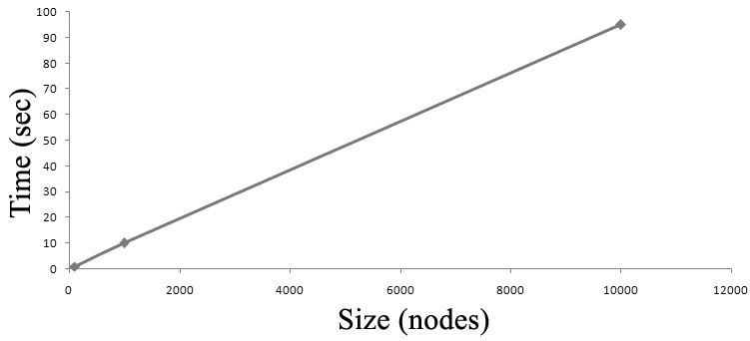
Sequential Search
If your list contains N elements, and the target element is at a random position in the list then on average it will take N/2 checks to find your element. When the time an algorithm takes to complete is directly related to the size of the array (N), we call this algorithm linear and the notation is O(N).

Slide 6
Binary Search: Divide and Conquer
Binary search is a much faster algorithm, but requires that the list be sorted.
We can use the fact that the list is sorted to reduce the problem to smaller problems.
An algorithm that breaks the problem into smaller subproblems is called a divide-and-conquer algorithm.
1
3
6
7
9
12
13
16

Slide 7
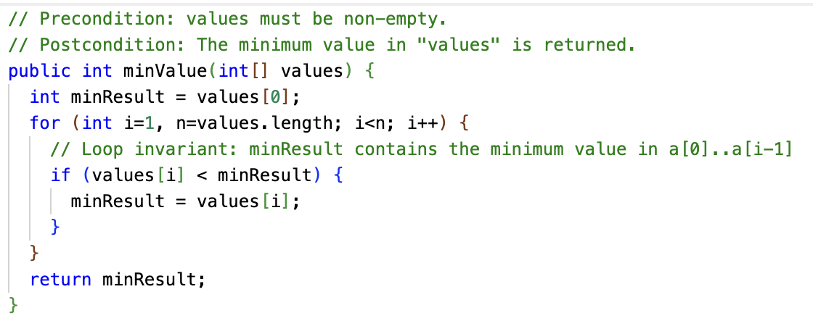
Loop Invariants
A loop invariant is a condition that must be true at the beginning and end of the body of a loop. (It might not be true while the loop body is doing its work, like swaps.)

Slide 8
Iterative Binary Search Algorithm
// Precondition: array must be in sorted order low ← 0, high ← length(array)-1 while low <= high // Loop invariant: A[0...low-1] < targetValue < A[high+1...length(array)-1] middle ← (low + high) / 2 if array[middle] == targetValue return middle else if array[middle] < targetValue low ← middle + 1 else high ← middle - 1 end if end while return not found

Slide 9
Recursive Binary Search Algorithm
// Precondition: array must be in sorted order def binarySearch(array): return binarySearchHelper(array, 0, length(array)-1) def binarySearchHelper(array, low, high): if low > high, return not found middle ← (low + high) / 2 if array[middle] == targetValue return middle else if array[middle] < targetValue return binarySearchHelper(array, middle + 1, high) else return binarySearchHelper(array, low, middle - 1) end if end
Iterative or recursive binary search?
Iterative binary search is marginally faster and more memory-efficient, but the difference is ultimately insignificant.

Slide 10
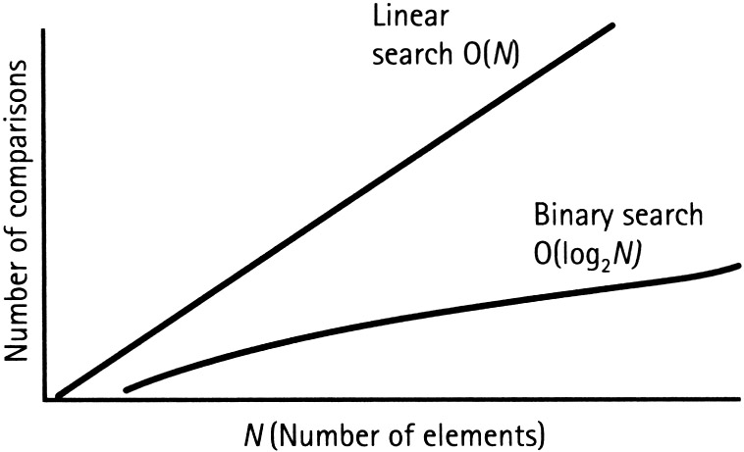
Binary Search
If your list contains N elements, and the target element is at a random position in the list then on average it will take log₂N checks to find your element. To give you a sense of this speedup, the log₂1024 = 10 (since 2¹⁰ = 1024). This means that binary search runs 10x faster on sorted lists of length ~1K. The notation for this algorithm is O(log N)

Slide 11
Comparing Sequential Search vs Binary Search (These are "worst case" numbers.)
N | Sequential Search Comparison Count | Binary Search Comparison Count
2 | 2 | 2
4 | 4 | 3
8 | 8 | 4
16 | 16 | 5
100 | 100 | 7

Slide 12
Insertion Point
One thing we didn't cover the first time around on binary search is how it can be used to find the insertion point.
A loop invariant of binary search is that all elements at indexes 0...low-1 must precede the target value, that is
A[i] < targetValue for all i=0...low-1
If they didn't, we would still be looking for the target value in that range.
If we get to the return at the end, low represents is the insertion point... the place in the array where targetValue should be inserted to preserve the ordering.
// Precondition: array must be in sorted order low ← 0, high ← length(array)-1 while low <= high // Loop invariant: // A[0...low-1] < targetValue < A[high+1...length(array)-1] middle ← (low + high) / 2 if array[middle] == targetValue return middle else if array[middle] < targetValue low ← middle + 1 else high ← middle - 1 end if end while return not found, insertion point is low

Slide 13
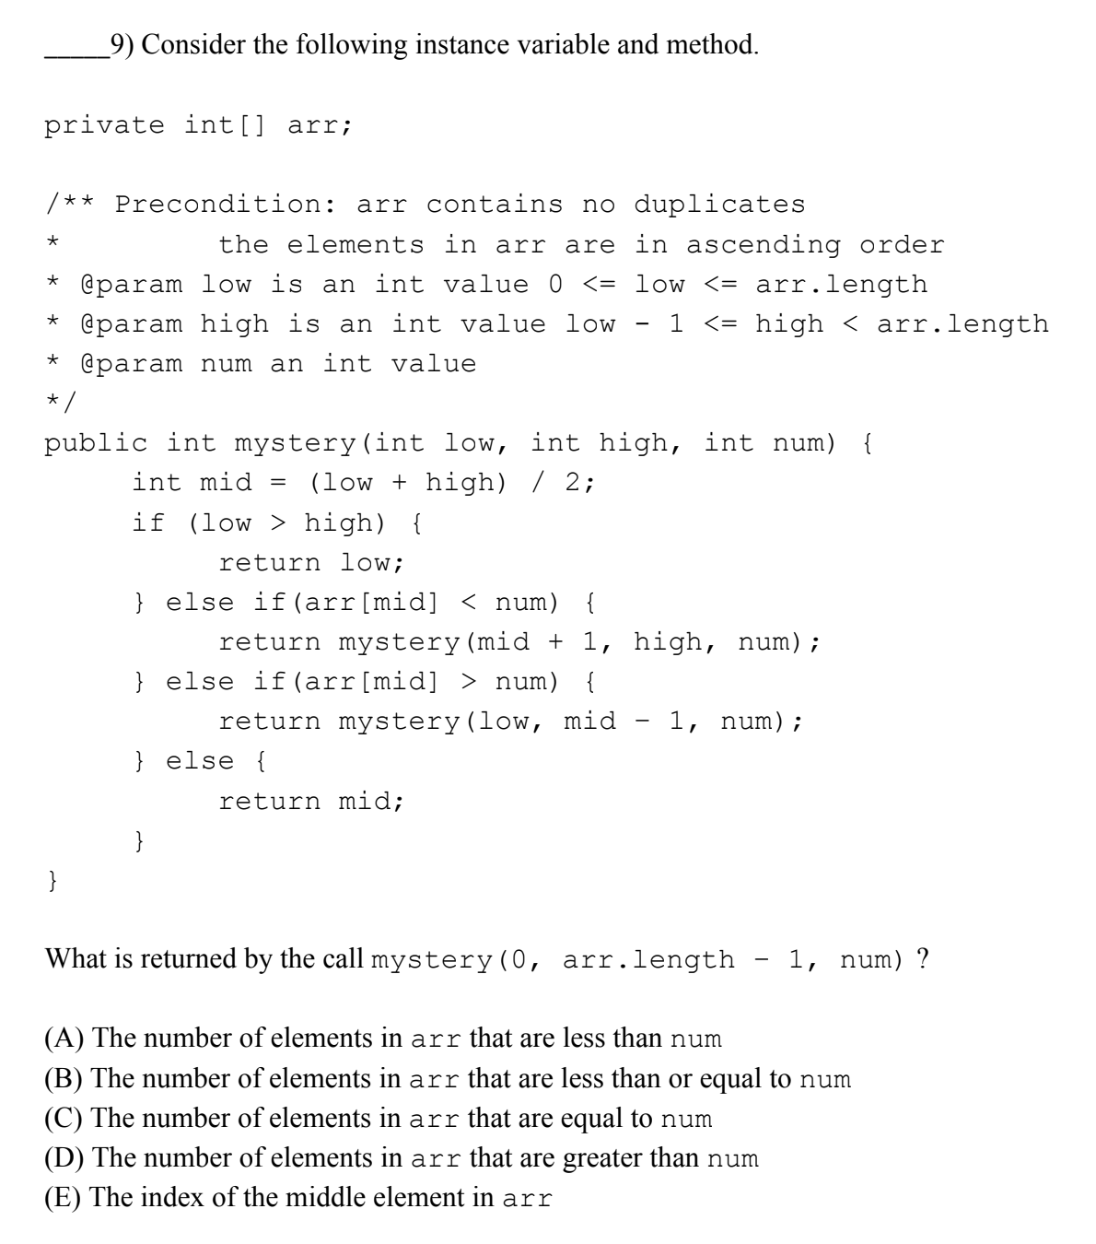
Insertion Point
mystery is recursive binary search... but it returns low if the value is not found.
If mystery finds num, it returns its index. This index equals the count of elements that are less than num. (Remember, no duplicates.)
If mystery doesn't find num, the loop invariant says everything to the left of low is less than num. So, low will still equal the count of elements less than num.
This question was really hard! But it seemed to be something that you'd actually see on the AP exam. It probably is from a real AP exam.

Slide 14
Sorting Algorithms we covered
Selection Sort | Insertion Sort | Merge Sort
• Slow, and consistently slow • Always performs N²/2 comparisons and 0...N swaps • Best case, average case and worst case all the same | • Slow for large numbers of elements • One of fastest algorithms for small numbers of elements • Does well on partially sorted data. • Best case: Already sorted array. N comparisons, 0 swaps • Average case: About half the comparisons of Selection Sort • Worst case: Entirely reversed array. N²-N comparisons and about same number of swaps | • Fast, efficient algorithm that scales up to large numbers of elements • Due to complexity, can be slower than Insertion Sort on very small numbers of elements • Best case, average case and worst case are O(N log N) comparisons • Can be combined with algorithms like Insertion Sort (used for small sublists)

Slide 15
Selection Sort Algorithm
Let's run through it on the whiteboard...
for i ← 0 to length(array)-1 // Loop invariant: The array to the left of i contains // the i smallest values in the array, in sorted order. jMin ← i for j ← i+1 to length(array)-1 // Loop invariant: A[jMin] is smallest value in range A[i]...A[j-1] if A[j] < A[jMin] then jMin ← j end for if jMin != i then swap A[i], A[jMin] end for

Slide 16
Selection Sort – an intuitive but slow algorithm
O(N²) is also known as quadratic time. Many simple sort algorithms are quadratic time.
It can be OK for a small number of elements, but as N gets big, the algorithm's running time becomes very long.
In Unit 10, we will learn a sorting algorithm, merge sort, that has much better running time: O(N log N). But it's also more complicated to code!
N | N²
1 | 1
10 | 100
100 | 10,000
1000 | 1,000,000
10000 | 100,000,000
100000 | 10,000,000,000
1000000 | 10¹²

Slide 17
Insertion Sort
Insertion Sort is more complex than Selection Sort, but is much faster when the data is partially sorted.
Insertion Sort is still a quadratic algorithm, that is, O(N²).
Insertion Sort is faster in practice than other quadratic algorithms such as Selection Sort.
Insertion Sort is actually one of the fastest known algorithms for sorting very small arrays. (Around <=10 items.)

Slide 18
Insertion Sort Algorithm
Insertion Sort has a loop invariant that for index i, the entire sub-array to the left of i is in sorted order.
This is slightly different from Selection Sort's loop invariant... how?
Insertion Sort's outer loop starts with i = 1, that is, pointing to the second element in the array.
Why? The sub-array to the left of i = 1, a[0..0], is in sorted order, because a one-element array is always in sorted order!

Slide 19
Insertion Sort Algorithm: Swapless Edition
// A bit more efficient than swapping. Less read/write operations. // Note we start with second element i = 1 for i ← 1 to length(array)-1 // Loop invariant: The array to the left of i is a sorted sub-array. // Save the value at A[i], as it may be overwritten x ← A[i] // j will represent the insertion point of the value. j ← i while j > 0 and A[j-1] > x // As we scan for insertion point, we move elements // to the right. A[j] ← A[j-1] j ← j - 1 end while // Finally, write the element being inserted into its final spot. A[j] ← x end for

Slide 20
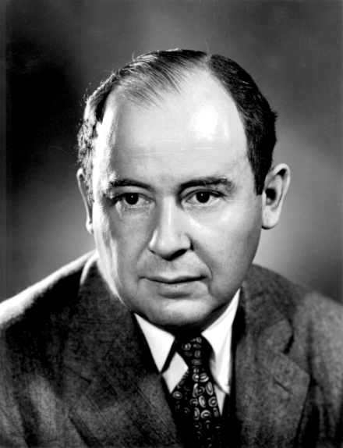
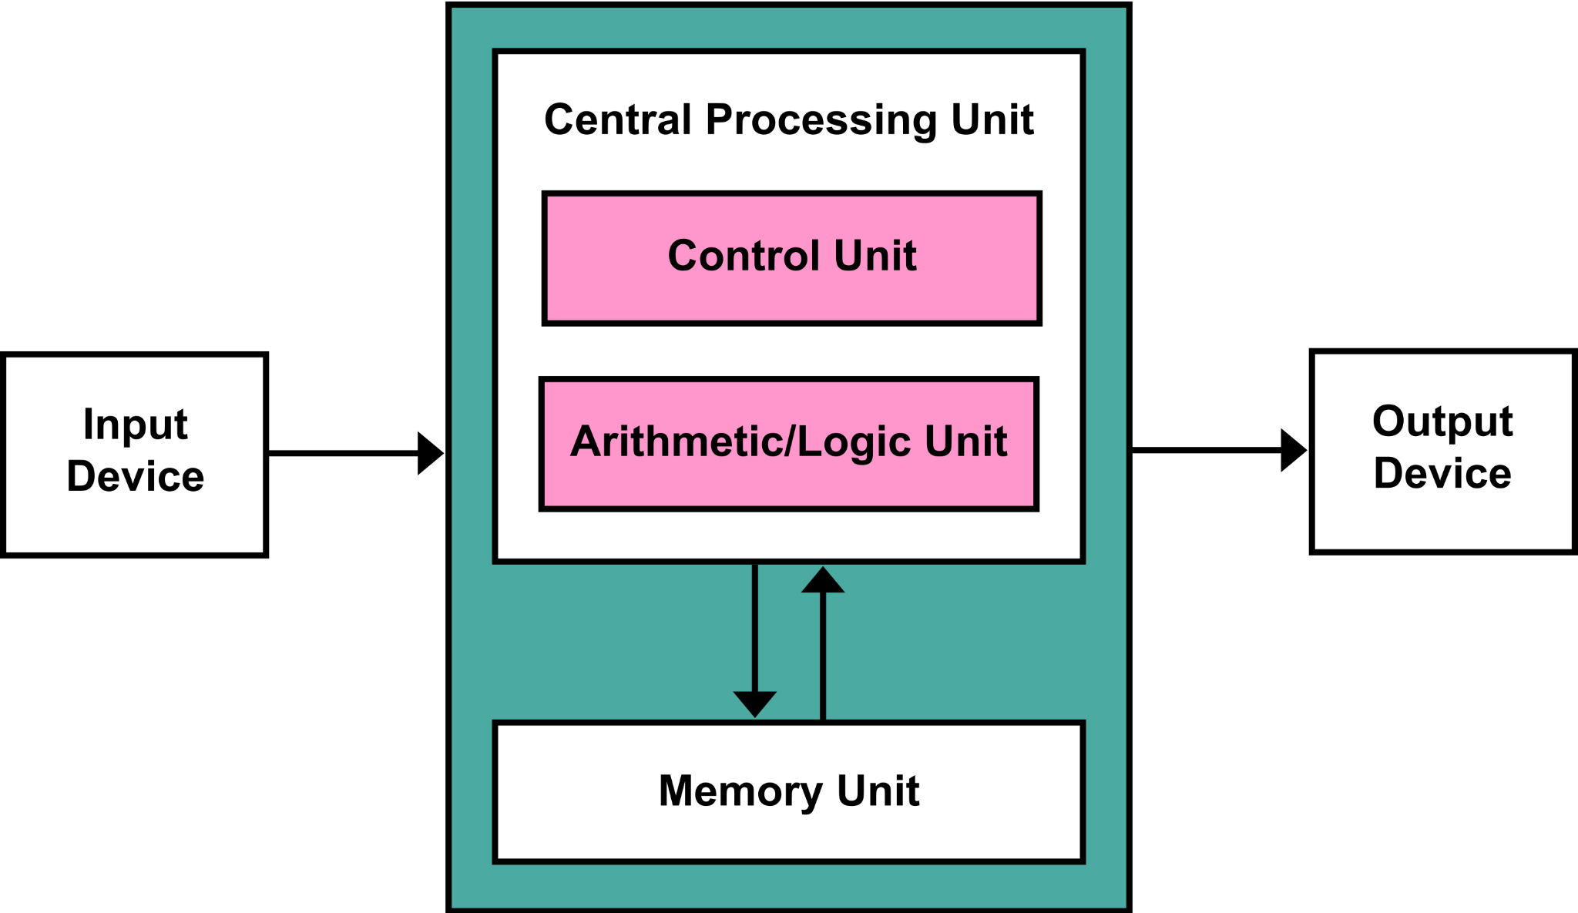
Merge Sort
Merge Sort is a divide and conquer sorting algorithm, much like Binary Search is a divide and conquer search algorithm.
Merge Sort divides the input array in half, and recursively Merge Sorts the halves.
This algorithm was invented in 1945 (!) by John Von Neumann (1903-1957), a genius mathematician and early computer scientist.
Among other things, Von Neumann invented the Von Neumann Architecture, which is still the conceptual model for how a computer works.

Slide 21
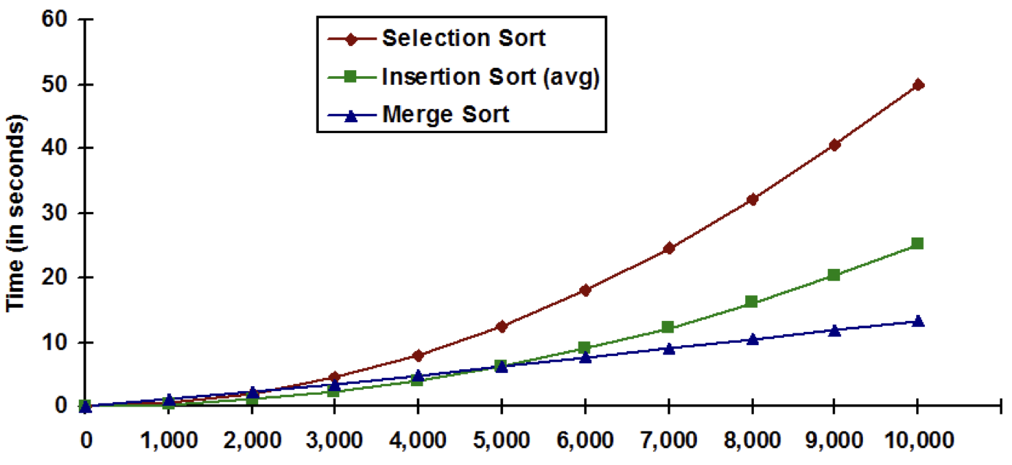
Sorting Algorithm Efficiency
Merge sort worst case performance is O(n log n)

Slide 22
Merge Sort: Split the array into halves down to one element
38
27
43
3
9
82
10
38
27
43
3
9
82
10
38
27
43
3
9
82
10
38
27
43
3
9
82
10

Slide 23
Merge Sort: Sort the halves and merge them together
38
27
43
3
9
82
10
27
38
3
43
9
82
10
3
27
38
43
9
10
82
3
9
10
27
38
43
82

Slide 24
Merge Sort Pseudocode
If the list’s size is 0 or 1, just return the original list (as it is sorted)
Split the list parameter int two lists of roughly equal size
Recursively Merge Sort both split lists, list 1 and list 2
Merge the two sorted lists and return the result

Slide 25
Merge Sort "Lists"
Conceptually, you can think of Merge Sort as splitting the input into a bunch of smaller sub-lists, and recursively merging all the sub-lists together.
In practice, we don't want to create tons of lists! We want to allocate as little memory as possible, and copy as little data as possible. So we want to work as much as possible in the array being sorted.
This means that a "sub-list" is really a "view" into the original array, tracked with two indices, begin and end.
Because of Merge Sort's merge operation, we do need some temporary storage, but that comes out to one additional temporary array that is the same size as the array being sorted.

Slide 26
Merge Sort: The Merge
Array A
3
27
38
43
9
10
82
i
j
Array B
3
9
10
27
38
43
82
k (at start)
k (when done)
i = current index in left half, j = current index in right half. k = index in output array.
While i <= ending index of left half and j <= ending index of right half: B[k++] = smaller of A[i] and A[j]. Advance i if we used A[i], or advance j if we used A[j].
After, one of the halves may still have something left... output anything left over into B.

Slide 27
CSAwesome's Merge Sort (edited for brevity) [1/2]
public static void mergeSort(int[] elements) {
int n = elements.length;
int[] temp = new int[n];
mergeSortHelper(elements, 0, n - 1, temp);
}
private static void mergeSortHelper(int[] elements,
int from, int to, int[] temp) {
if (from < to) {
int middle = (from + to) / 2;
mergeSortHelper(elements, from, middle, temp);
mergeSortHelper(elements, middle + 1, to, temp);
merge(elements, from, middle, to, temp);
}
}

Slide 28
CSAwesome's Merge Sort implementation [2/2]
private static void merge(int[] elements, int from, int mid, int to, int[] temp) {
int i = from, j = mid + 1, k = from;
while (i <= mid && j <= to) {
if (elements[i] < elements[j]) {
temp[k++] = elements[i++];
} else {
temp[k++] = elements[j++];
}
}
while (i <= mid) {
temp[k++] = elements[i++];
}
while (j <= to) {
temp[k++] = elements[j++];
}
for (k = from; k <= to; k++) {
elements[k] = temp[k];
}
}
Here, we're comparing the current elements from each half, and taking the smaller one. We only advance the pointer for the side we took from!
If we got here, one or both halves are done. Output anything left over from the left half.
Output anything left over from the right half. (Only one of these loops will run.)
Copy everything back from the temp array. (This can be avoided with some extra fanciness.)

Slide 29
Final slide before the Final and AP Exam
GOOD LUCK!

